Slide 1
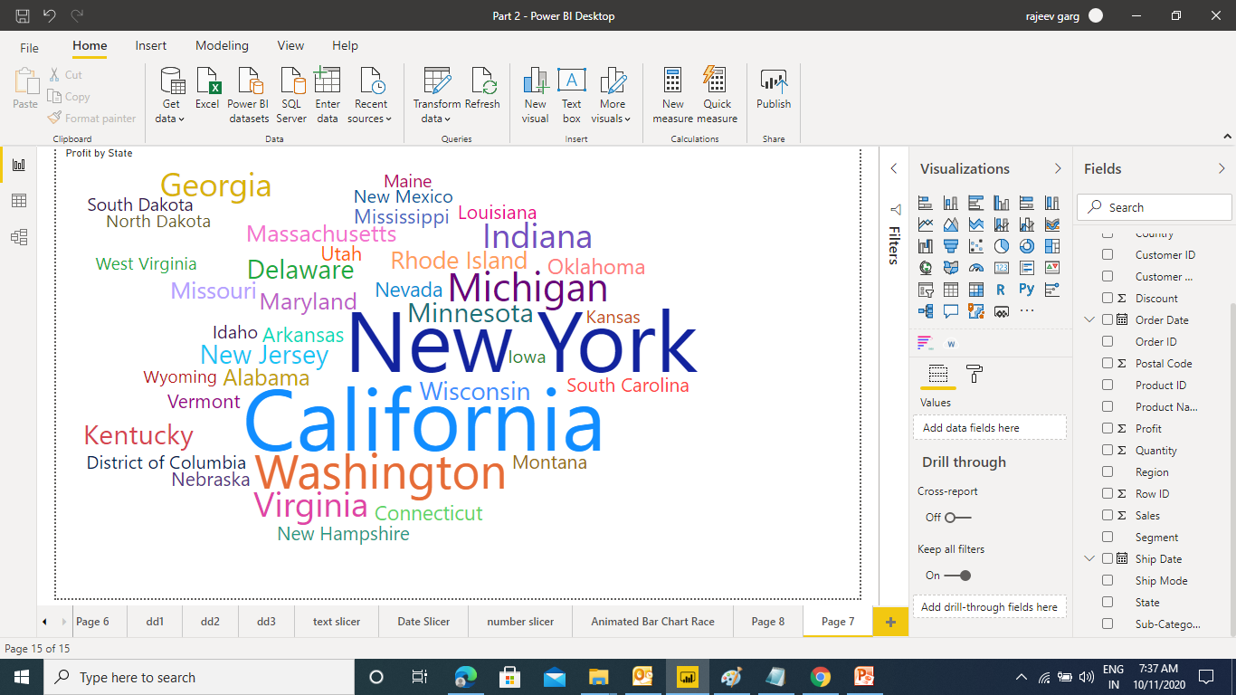

Advance Charts in Power BI
Word Cloud
Ensure that the Word Breaking Option under General Section is Off

Slide 2
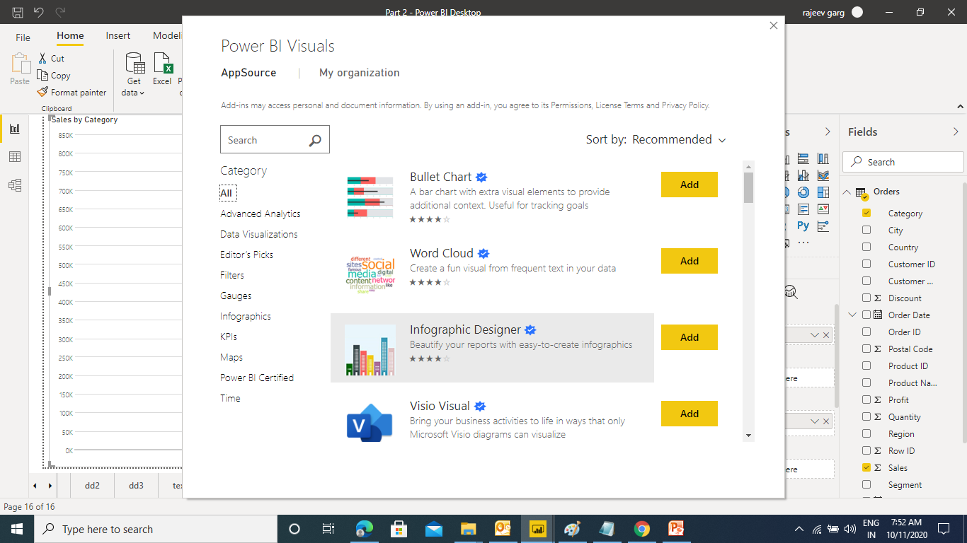
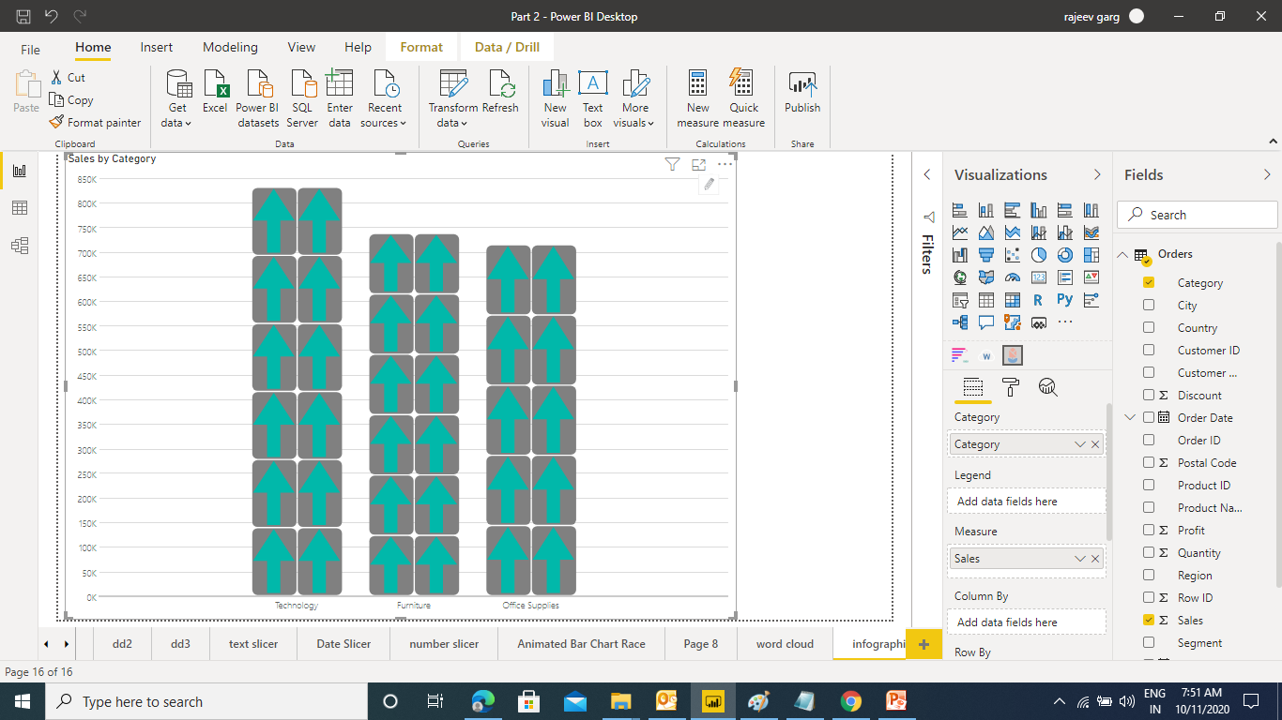
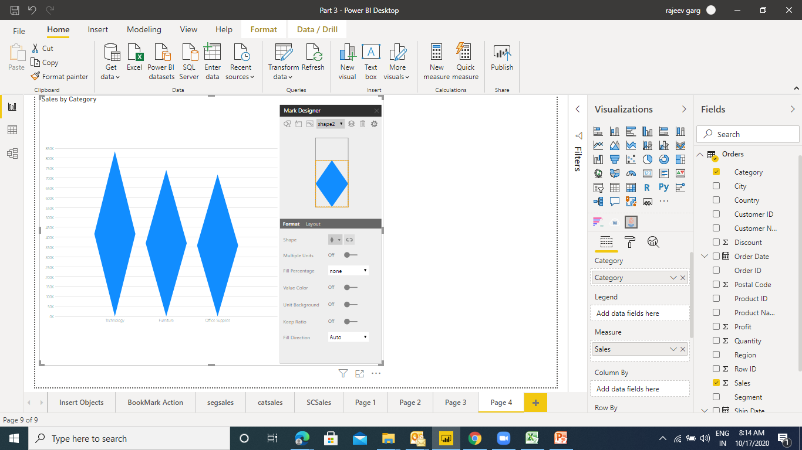
Advance Charts in Power BI
Info Graphic
Click on the edit button on the chart to edit the shape

Slide 3
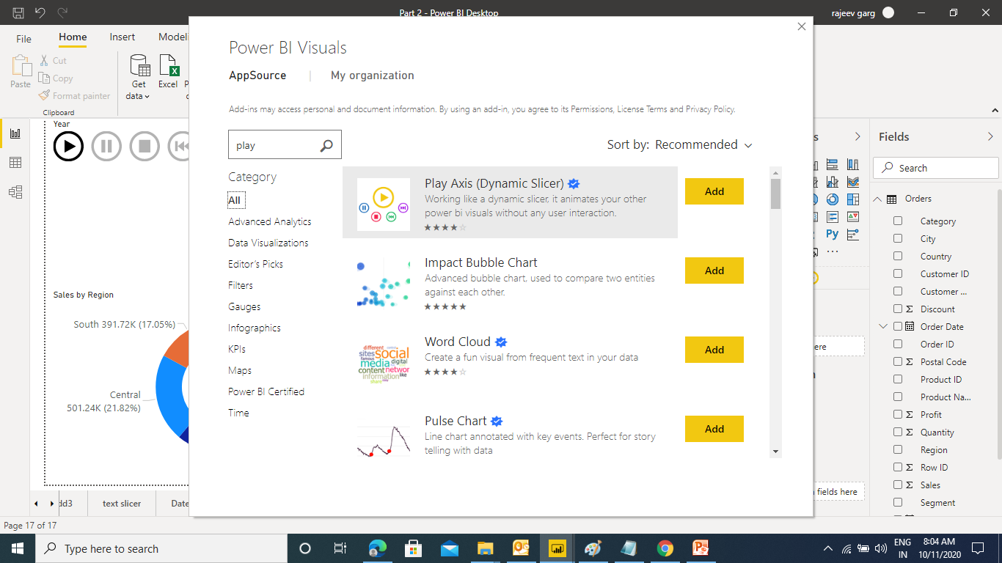
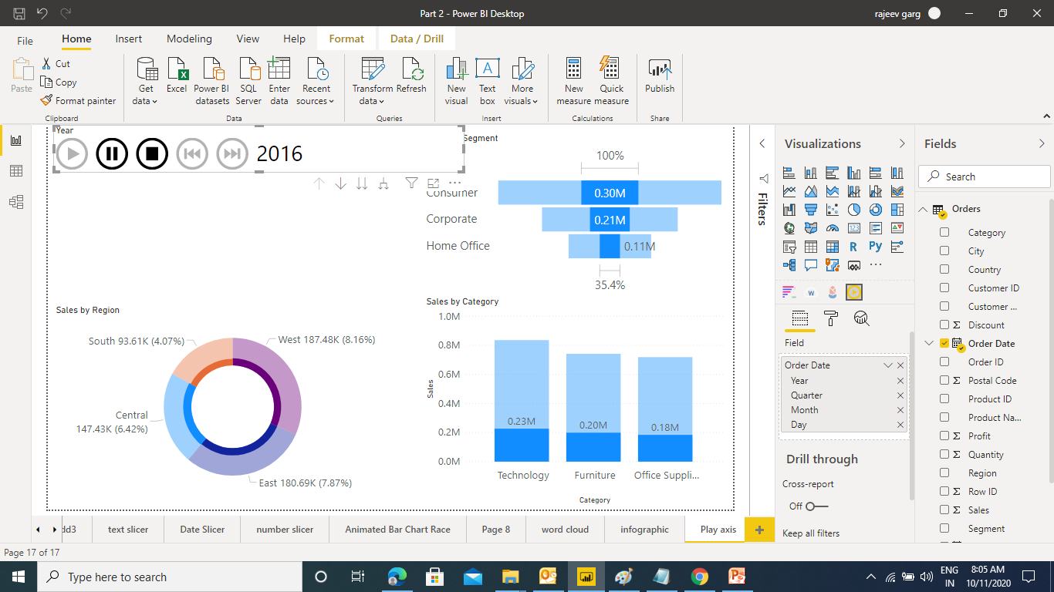
Advance Charts in Power BI
Play Axis

Slide 4
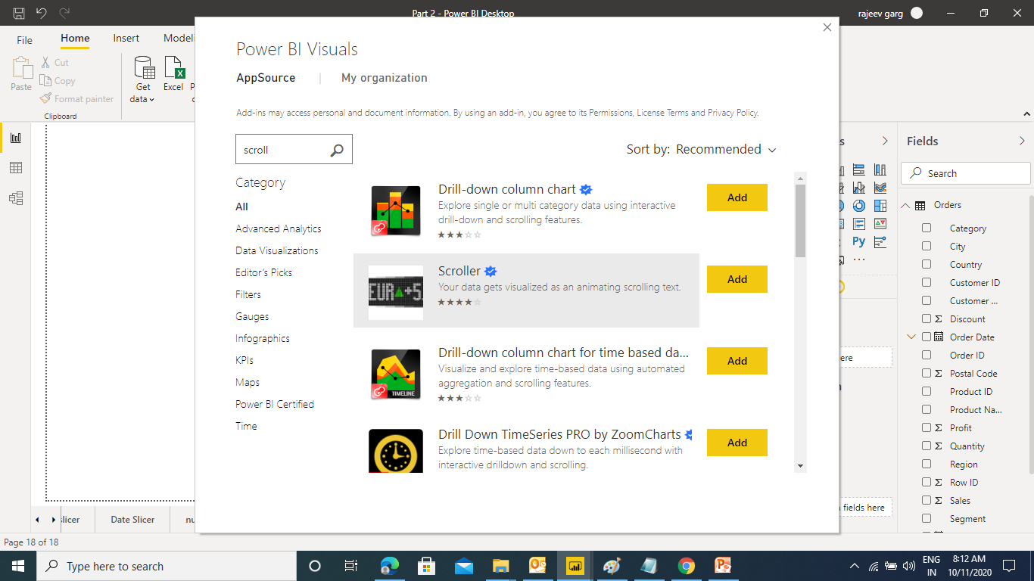
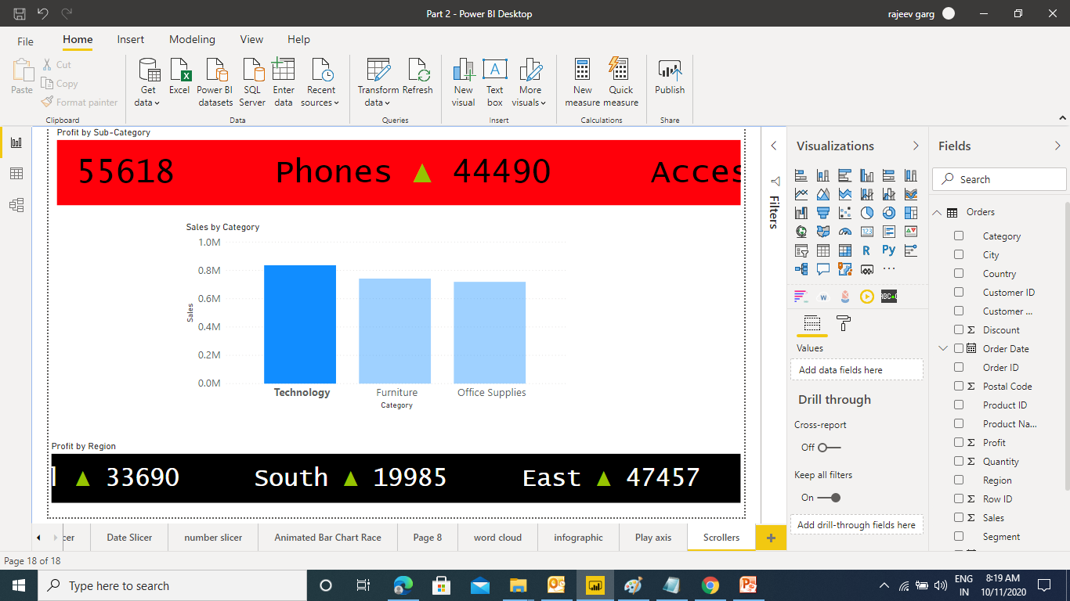
Advance Charts in Power BI
Scroller

Slide 5
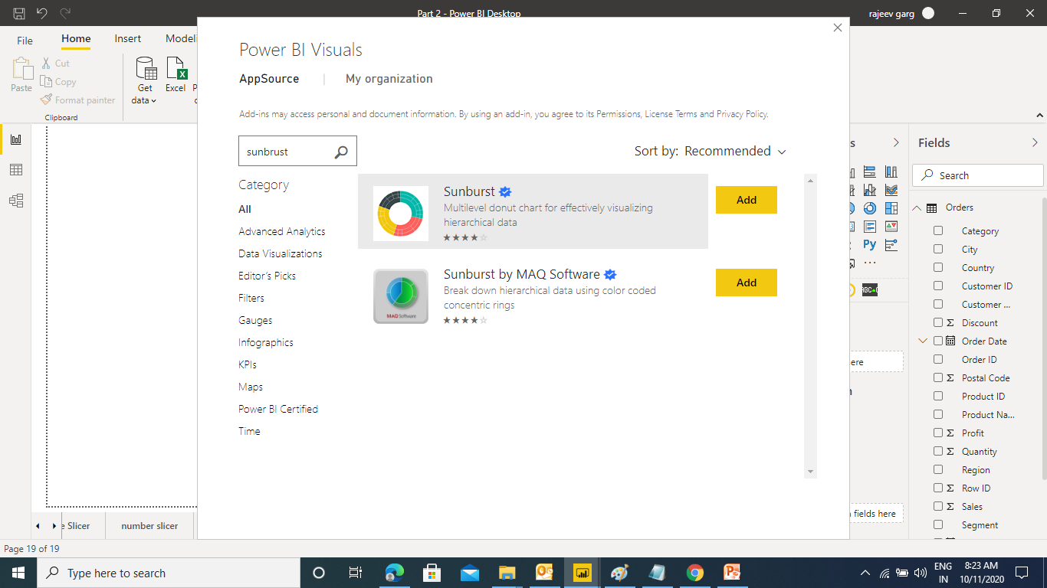
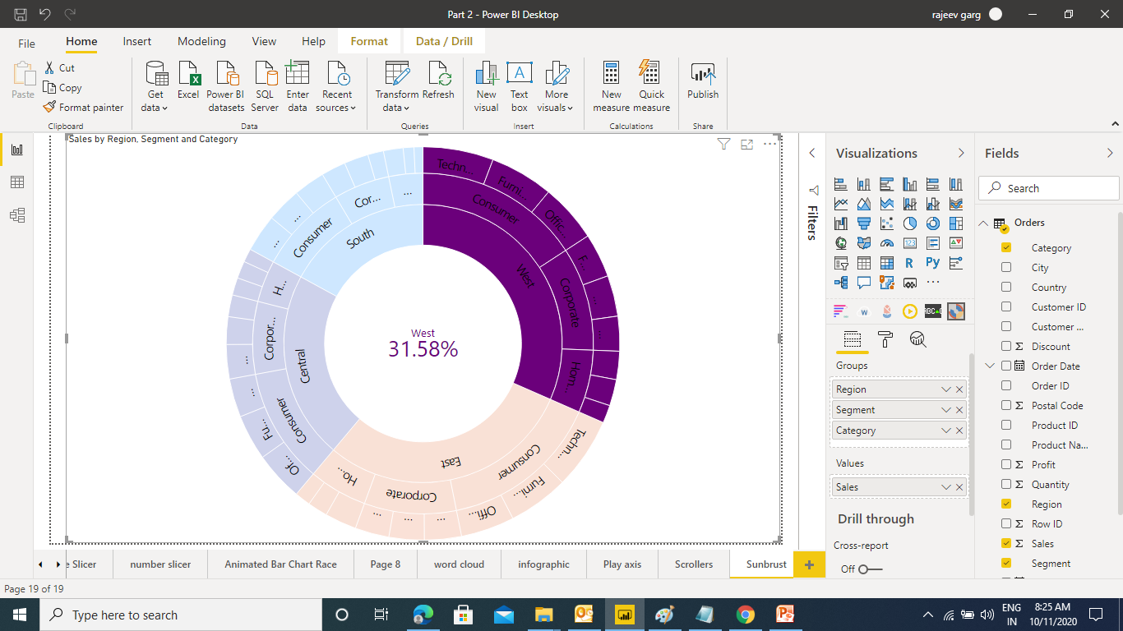
Advance Charts in Power BI
Sunbrust

Slide 6
Inserting Objects in Power BI
Picture
Shape
Text Box
Button
Action URL
Navigation
Bookmark
Drill-through

Slide 7
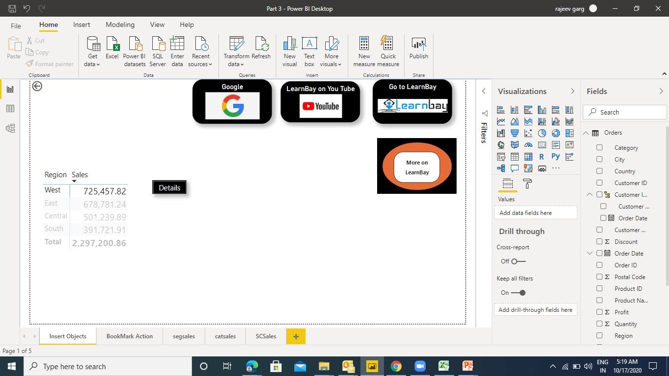
Inserting Objects in Power BI

Slide 8
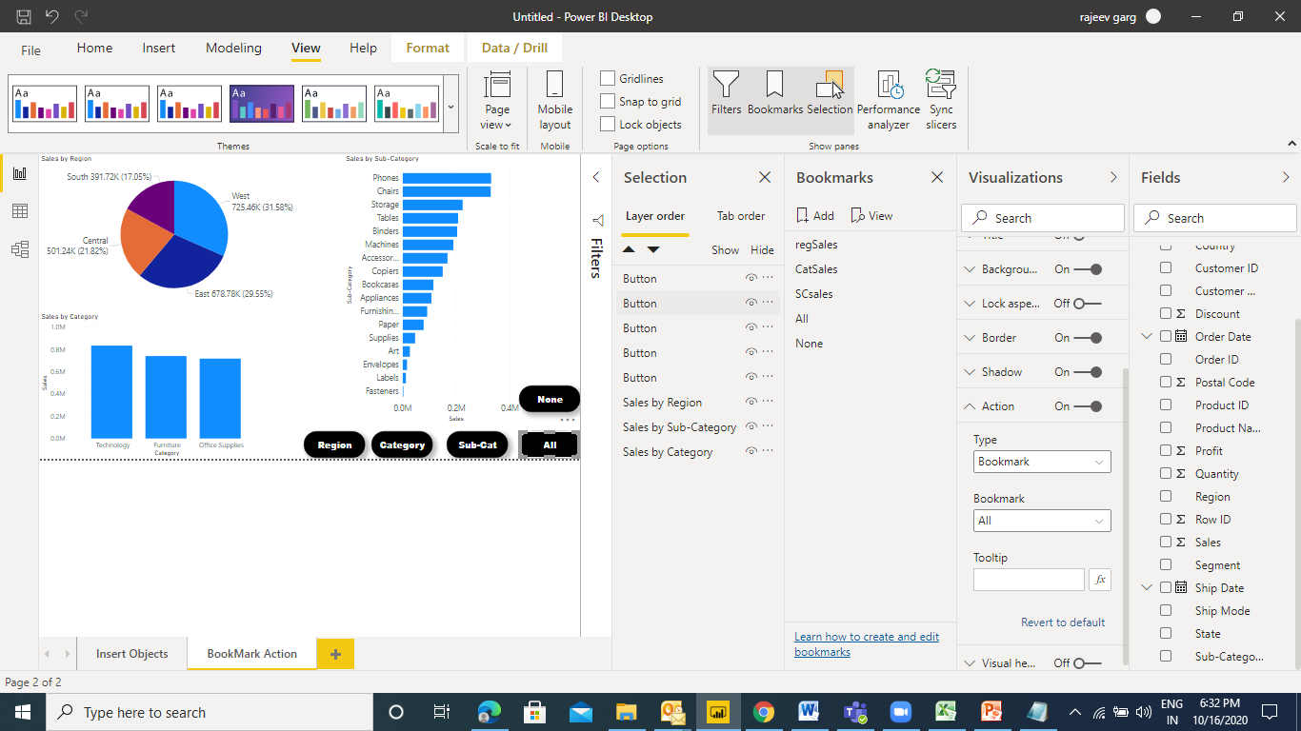
Book Mark Action in Power BI
Bookmark Action is a collection of Book Mark, Buttons, Selection page & Action

Slide 9
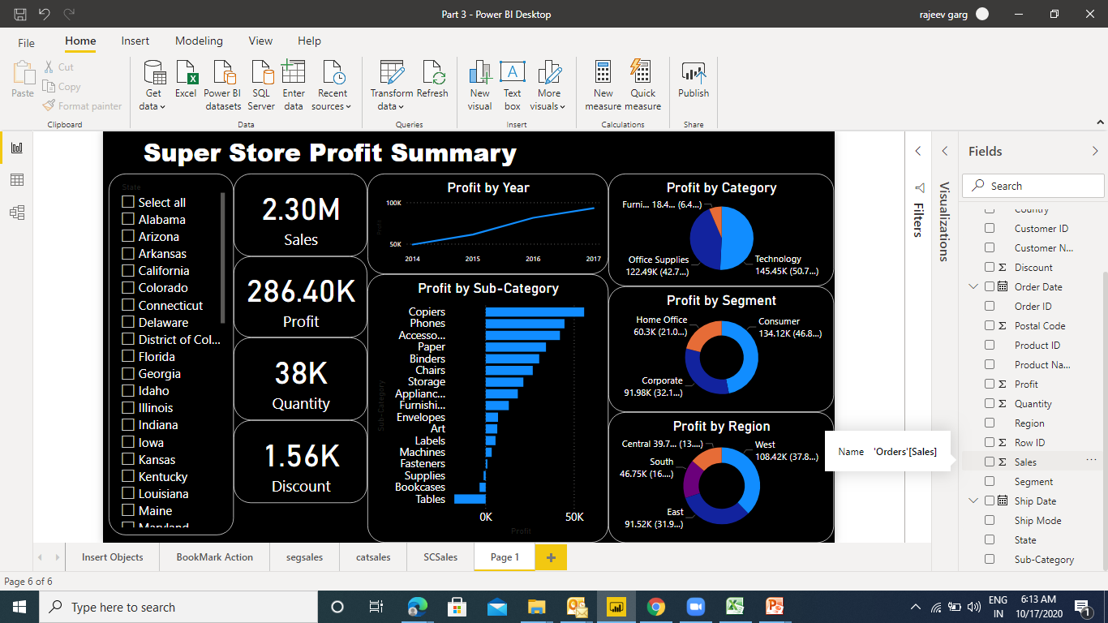
Creating Report in Power BI
A Report is a combination of multiple Visuals

Slide 10
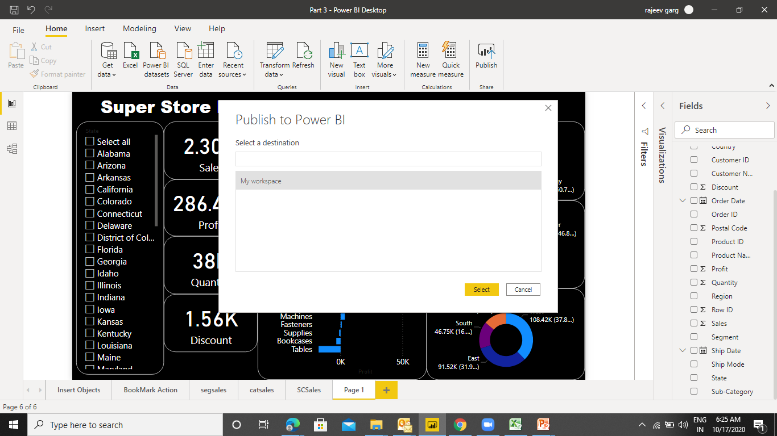
Publishing On Power BI Service
Power BI Service is a sharing tool to share the visualization with other users.
You need to create a Power BI Service account and publish your creation on it
Home - > Publish

Slide 11
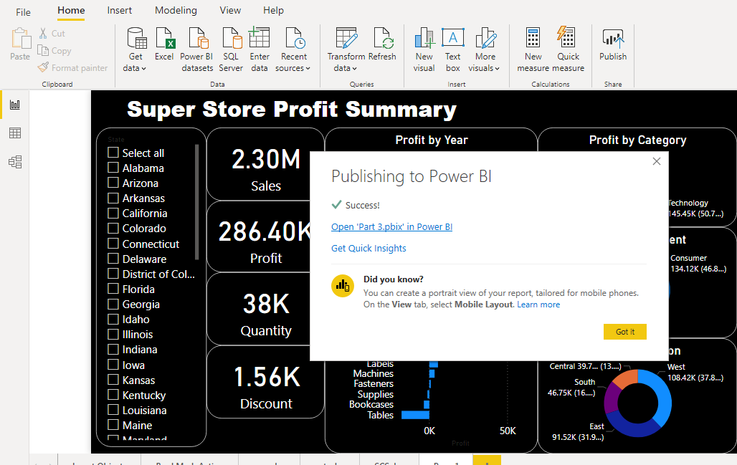
Publishing On Power BI Service

Slide 12
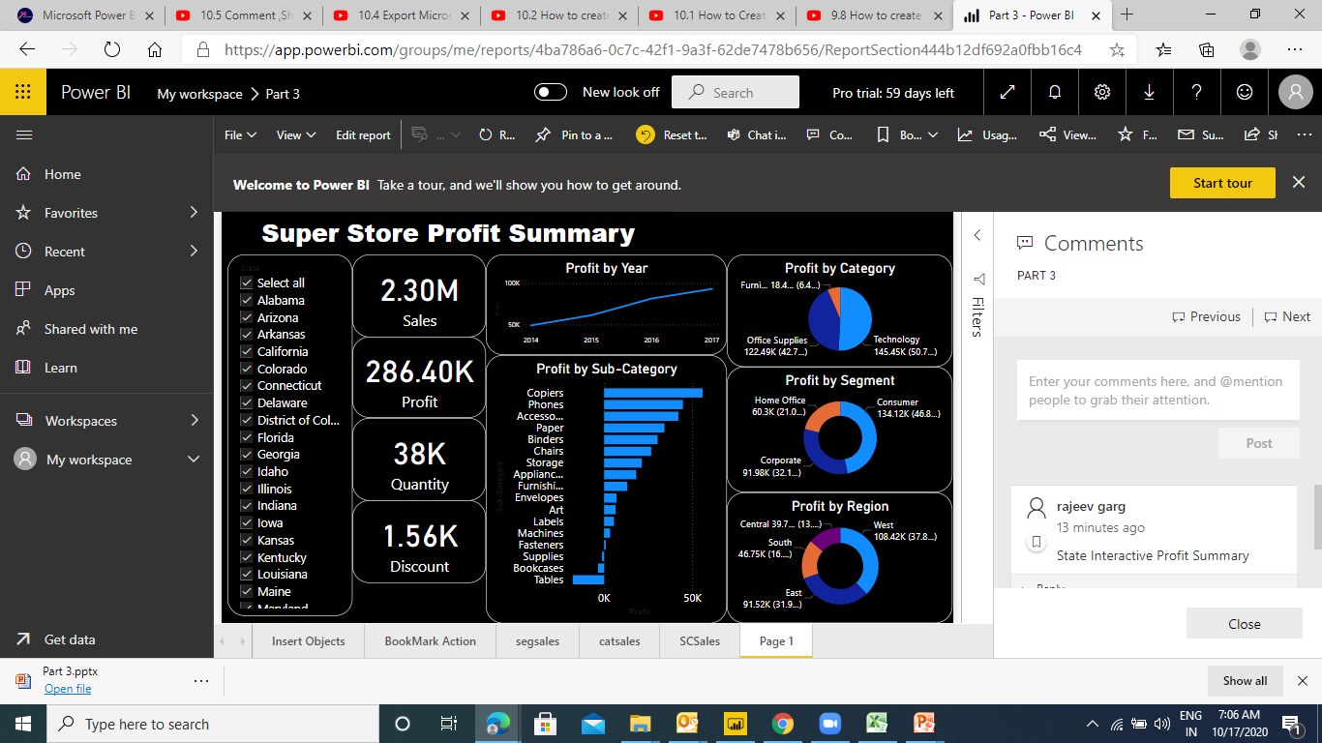
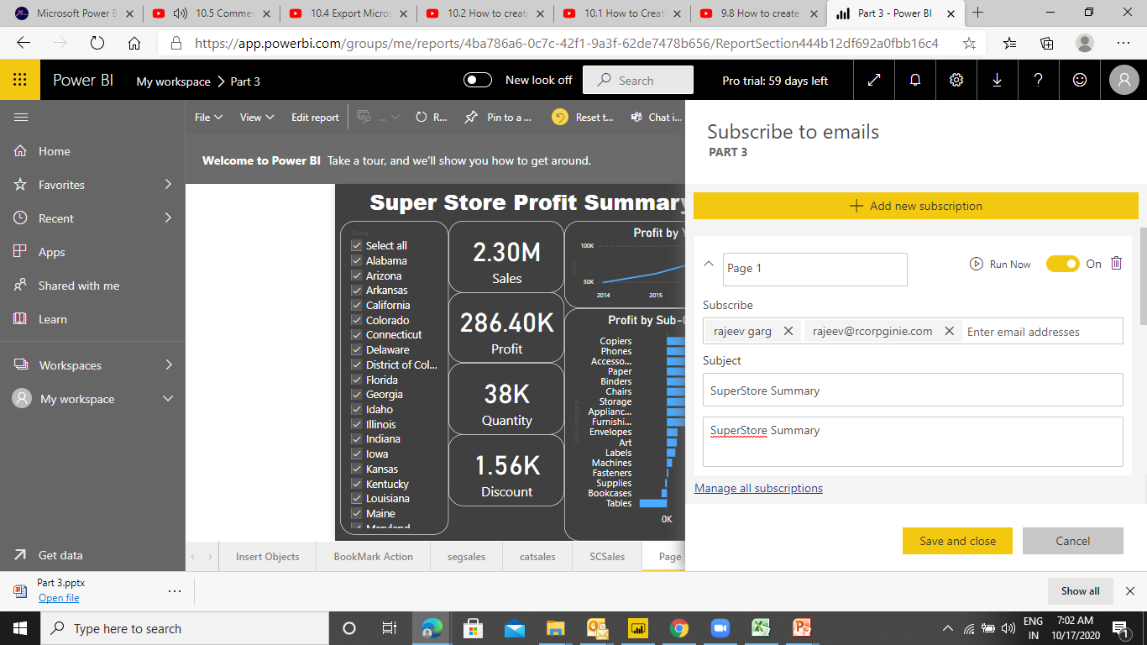
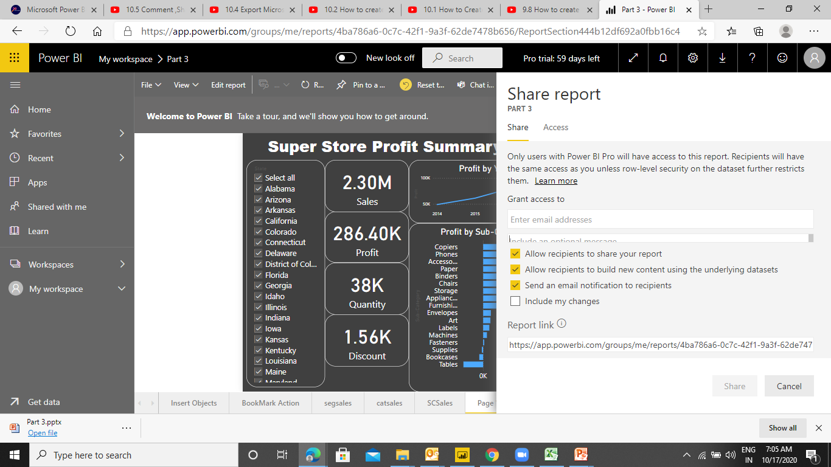
Power BI Service
Comments, Subscribe, Share

Slide 13
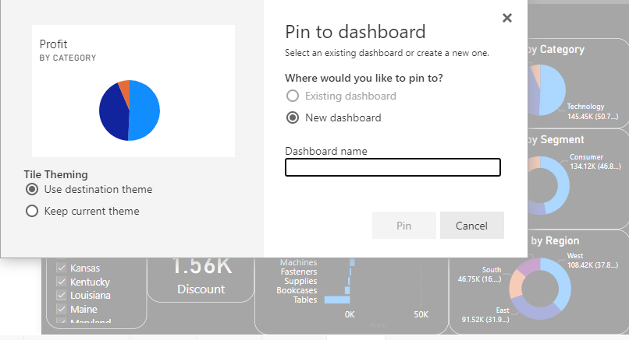
Dashboard in Power BI
In Power Bi dashboard can be created only in Power BI Service. To ad a visual you just need to pin the Visual to the dashboard.
Dashboard can also be created through My workplace.

Slide 14
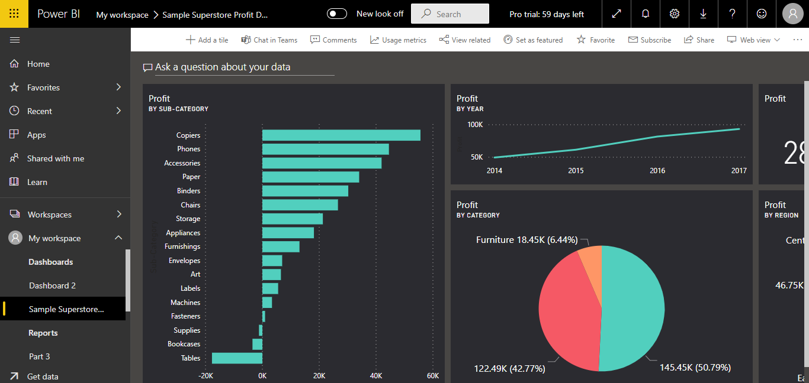
Dashboard in Power BI
PowerBi Dashboard are not interactive by default. To make the dashboard interactive you need to pin the live page.
These are actually useful if you want to see the static view.

Slide 15
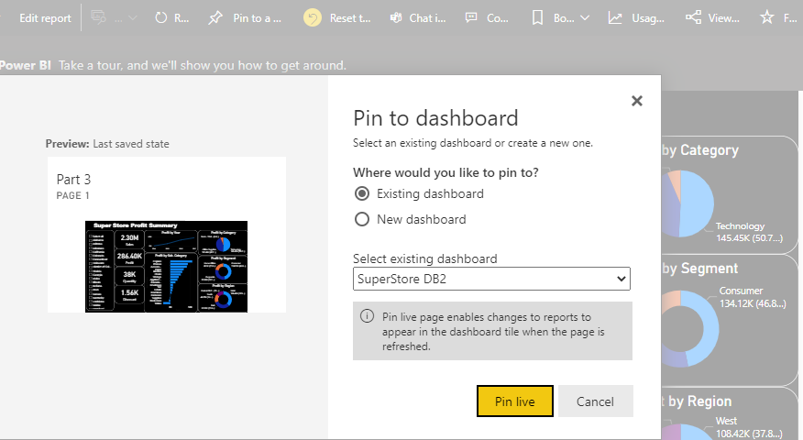
Dashboard in Power BI
Power Bi dashboards are not interactive by default.
To make the dashboard interactive you need to pin the live page.
In the real time scenario Reports are majorly used.
These are actually useful if you want to see the static view.

Slide 16
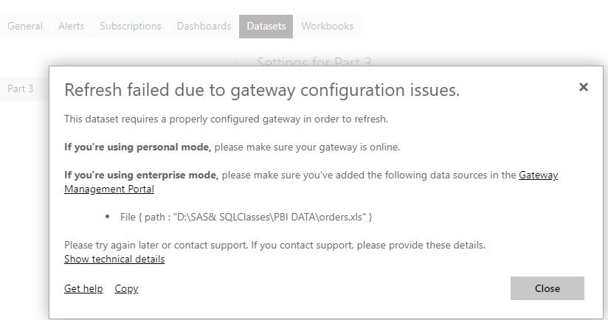
Refreshing Data in Power BI
To refresh the data you need to go to : My workspace ->Datasets -> Refresh

Slide 17
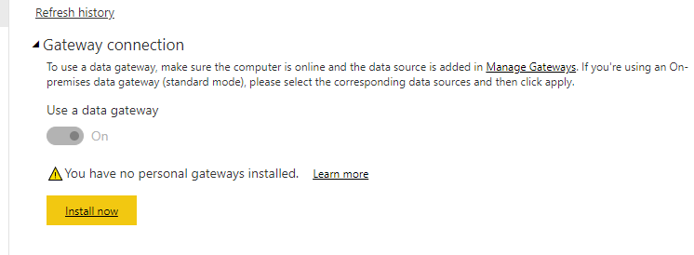
Refreshing Data in Power BI
The Refresh failed message is displayed as the Data Gateway is not configured. To resolve this : Download & Install Data Gateway.
Refresh the dataset
Check for Username & password under
My workspace ->Datasets -> Settings -> Data Source Credentials
Scheduled refresh (8 Schedules in Pro & 48 in Premium Account)

Slide 18
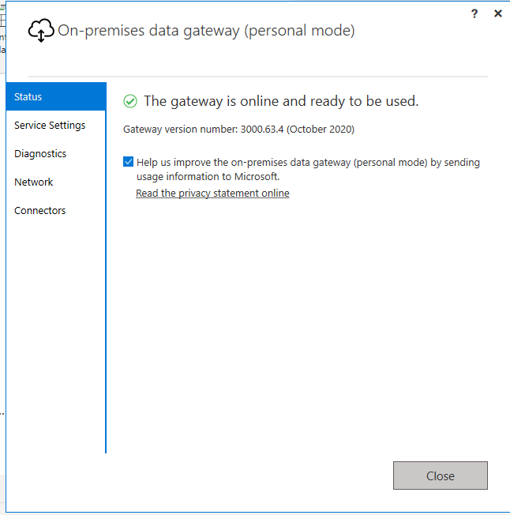
Refreshing Data in Power BI
Once the Gateway is installed and configured successfully, below confirmation will be displayed.
Refresh the dataset
Check for Username & password under
My workspace ->Datasets -> Settings -> Data Source Credentials
Scheduled refresh (8 Schedules in Pro & 48 in Premium Account)

Slide 19
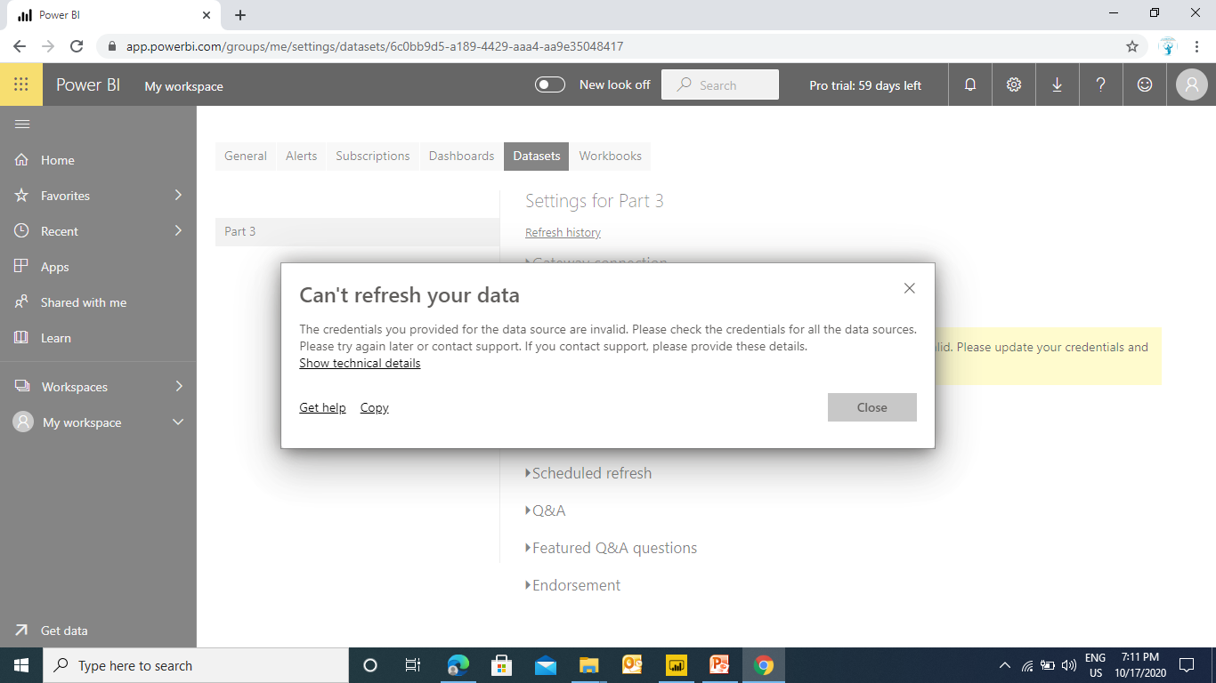
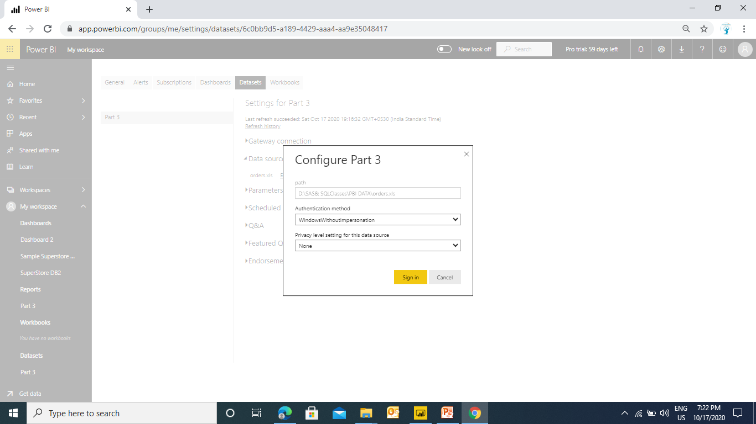
Refreshing Data in Power BI
Now try to refresh the Dataset. You may be prompted with the below message.
To resolve this you need to specify the Data source credentials
Refresh the dataset
Check for Username & password under
My workspace ->Datasets -> Settings -> Data Source Credentials
Scheduled refresh (8 Schedules in Pro & 48 in Premium Account)

Slide 20
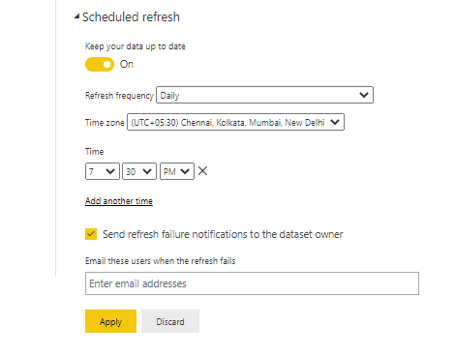
Scheduled Refresh in Power BI
You can automate the refresh by scheduling a refresh.
Turn on the Scheduled Refresh
Specify the frequency (Daily / Weekly)
Set the time
Specify a refresh failure email recipient
Apply
Refresh the dataset
Check for Username & password under
My workspace ->Datasets -> Settings -> Data Source Credentials
Scheduled refresh (8 Schedules in Pro & 48 in Premium Account)
Note : Refresh can be done 8 times a day in Pro Account
In Premium account it can be done 48 times

Slide 21


Visualize the data in any meaningful way to help the institute to analyse the data.
Design a report for the planning data based on country, institute, department, year, quarter, and qualification.
KPI
No of Students per Country
No of Students per Institute
No of Students per Department
No of Students per Qualification
Percentage of Withdrawn cases
Time series analysis of active and withdrawn classes

